Slide 1
GECCO 2024 Sample PowerPoint File:
Title Goes Here
Authors’ Full First & Last Names
Corporate or Academic Affiliation
Location City, State, Country
Presenter’s Contact Information-Email
http://gecco-2024.sigevo.org/
Permission to make digital or hard copies of part or all of this work for personal or classroom use is granted without fee provided that copies are not made or distributed for profit or commercial advantage and that copies bear this notice and the full citation on the first page. Copyrights for third-party components of this work must be honored. For all other uses, contact the owner/author(s).
To be updated after completing copyright process
GECCO '24 Companion, July 14 - 18, 2024, Melbourne, Australia
© 2024 Copyright held by the owner/author(s).
ACM ISBN 978-x-xxxx-xxxx-x/YY/MM. . . $15.00
https://doi.org/10.1145/nnnnnnn.nnnnnnn

Slide 2

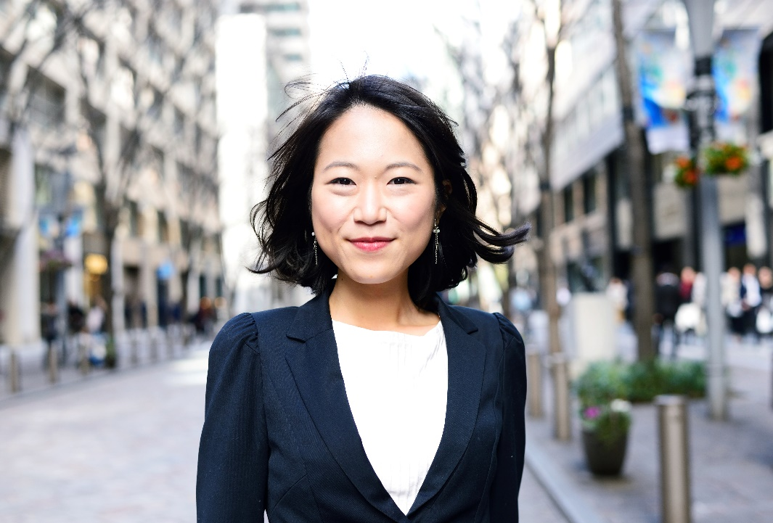
Instructors
John D. Smith is an Assistant Professor at Stanford University in the Center for Computer Research in Music and Acoustics (CCRMA), and researches interactive software systems and programming languages for computer music, mobile and social music, musical interaction design, sound synthesis and visualization, new performance ensembles, and education at the intersection of computer science and music.
Jane Doe-Brown is Professor of Linguistics and Professor by Courtesy of Computer Science at Stanford University. Jane received a B.A in Linguistics in 1983 and a Ph.D. in Computer Science in 1992, both from the University of California at Berkeley, and taught at the University of Colorado, Boulder from 1996-2003 before coming to Stanford.

Slide 3
Course Agenda
Introduction
Step 1
Step 2
  Clustering
Step 3
  Sample Graphs
  Sample Table
Step 4
  Networks
Step 5
Overview, Examples, Questions & Discussion

Slide 4
Format and Deadline
Preparing the CRC

Slide 5
Tutorial’s CRC
Please prepare your GECCO’24 Tutorial in 4 (four) slides per US letter page landscape orientation (11x8.5 inches). US letter is a standard page size in most slide applications.
The tutorial presentation must be in PDF format.
Avoid adding page numbers to the final PDF.
Fonts must be embedded.
Then submit PDF to the Linklings Submission System at:
  https://ssl.linklings.net/conferences/gecco/
Submission Deadline: May 10, 2024 (26 Apr for stage1)
120 SLIDE MAXIMUM: 30 pages of 4 up slides

Slide 6
Creating the PDF
Preparing the CRC

Slide 7
Producing and testing PDF files
We recommend that you produce a PDF version of your submission well before the final deadline. Your PDF file must be ACM DL Compliant. All fonts need to be embedded in the final PDF file. Avoid adding page numbers to the final PDF.
Test your PDF file by viewing or printing it with the same software we will use when we receive it, Adobe Acrobat Reader Version 7. This is widely available at no cost from [1]. Note that most reviewers will use a North American/European version of Acrobat reader, which cannot handle documents containing non-North American or non-European fonts (e.g. Asian fonts). Please therefore do not use Asian fonts, and verify this by testing with a North American/European Acrobat reader (obtainable as above). Something as minor as including a space or punctuation character in a two-byte font can render a file unreadable.

Slide 8
Creating your pdf from Windows7, PowerPoint 2010 using full versions of Adobe Acrobat
Control+P --or– File (drag down) to Print
Under Printer (Choose Adobe PDF)
Click “Printer Properties”
Click the tab “Layout”, under Layout
For “Orientation” choose “Portrait”
Click “Advanced”, under “Paper/Output” & “Paper Size” choose “US Letter”
Click OK, next screen Click OK
On the Print Menu “Settings”
Under Slides, make these choices and checks:
4 slide handout
uncheck “Frame Slides”
check “Scale to Fit”
check “High Quality”
Choose “Collated 1,2,3 1,2,3
Choose “Landscape Orientation”
Choose for Color Choice, choose “Grayscale”
Click PRINT
Name your pdf
Review your pdf to see that all colors that have changed to Grayscale are distinguishable and readable.

Slide 9
Creating your pdf from Windows10, PowerPoint 2013 and PowerPoint 2016 using full versions of Adobe Acrobat
Click the File tab and then click Export (not Save As).
Click Create PDF/XPS Document, then click Create PDF/XPS.
In the Publish as PDF or XPS box, choose a location to save the file to. If you want it to have a different name, enter it in the File Name box.
Click Options to set how the presentation will appear. Select the handouts option with 4 slides per page. Click OK when you’re finished to close the Options box.
Click Publish.

Slide 10
Copyright issues
Preparing the CRC

Slide 11
Third Party Material
In the event any element used in your Material contains the work of third-party individuals, please know that it is the author/presenters responsibility to secure any necessary permissions and/or licenses, and the authors will provide the same permissions in writing to ACM. If the copyright holder requires a citation to a copyrighted work, this is the authors responsibility to include the correct wording and citations to the copyrighted material in their submissions.

Slide 12
ACM Copyrights & Permissions Policy
Accepted extended abstracts, papers, and presentations will be distributed in the Conference Publications. They will also be placed in the ACM Digital Library, where they will remain accessible to thousands of researchers and practitioners worldwide. To view ACM’s copyright and permissions policy, see:
  http://www.acm.org/publications/policies/copyright-and-license-forms

Slide 13
Language and Style
Preparing the CRC

Slide 14
Language, style, and content
The written and spoken language is English. Spelling and punctuation may use any dialect of English (e.g., British, Canadian, US, etc.) provided this is done consistently. Hyphenation is optional. To ensure suitability for an international audience, please pay attention to the following:
Write in a straightforward style. Use simple sentence structure. Try to avoid long sentences and complex sentence structures. Use semicolons carefully.
Use common and basic vocabulary (e.g., use the word “unusual” rather than the word “arcane”).

Slide 15
Language, style, and content
Briefly define or explain all technical terms. The terminology common to your practice/discipline may be different in other design practices/disciplines.
Spell out all acronyms the first time they are used in your text. For example, “World Wide Web (WWW)”.
Explain local references (e.g., not everyone knows all city names in a particular country).
Explain “insider” comments. Ensure that your whole audience understands any reference whose meaning you do not describe (e.g., do not assume that everyone has used a Macintosh or a particular application).
Explain colloquial language and puns. Understanding phrases like “red herring” requires a cultural knowledge of English. Humor and irony are difficult to translate.

Slide 16
References and Citations
Use a numbered list of references at the end of the article, ordered alphabetically by first author, and referenced by numbers in brackets [2, 4, 5, 7]. For papers from conference proceedings, include the title of the paper and an abbreviated name of the conference (e.g., for Interact 2003 proceedings, use Proc. Interact 2003). Do not include the location of the conference or the exact date; do include the page numbers if available. See the examples of citations at the end of this document.

Slide 17
Fonts
Preparing the CRC

Slide 18
Fonts
It is best to use standard fonts.
Always embedded in the final PDF file
Arial, Myriad, or Helvetica
Times or Times New Roman

Slide 19
Images and Figures
Recommendations

Slide 20
Images & Figures Recommendations
Colors and Black & White (Gray Scale) Print Testing. If you have any images in color, please print your paper out in black and white to ensure that the tones and screens used in your images or figures reproduce well in black and white, too.
Resolution & CMYK: Images in your document should be at least 300 or 600 dpi for quality reproduction and saved as .tif images (or other compatible format that supports print quality resolution). When creating or revising your images for inclusion in the paper, we recommend choosing CMYK (and not RGB) as the color profile.
Rules/Lines: Rules used in your graphs, tables, or charts must be at least 0.5+ pt. and black for quality reproduction. Finer lines and points less than this size will not reproduce well, even if you can see them on your laser printed hardcopy -- your laser printers have a far lower resolution than the imagesetters that will be used.

Slide 21
Images & Figures Recommendations
TIF (EPS) vs JPG (JPEG) images. TIFs are preferred for press applications where quality takes priority over file size. When TIFs are compressed (LZW compression option when saving out of Photoshop, for example), no image data is lost, thus ensuring maximum quality. A JPEG is a compressed image format designed to keep the file size small, which makes it ideal for use in web graphics.To do this, the JPEG format actually deletes image data from the image. The higher the level of compression, the more data is removed. This is referred to as a lossy compression system. On a printout, the removed data tends to show up as blocky areas of a solid color. At higher resolutions (a minimum of 200 dpi), there's usually enough data in the JPEG file for the compression artifacts to be very noticeable.
Fonts: If your figure uses custom or any non-standard font, the characters may appear differently when printed in the proceedings. Remember to check your figure creation that all fonts are embedded or included in the figure correctly.
Transparencies: If a figure or image is assembled from multiple images, the images must be embedded, layers flattened or grouped together properly in the file, not lined. Transparencies need be flattened.

Slide 22
Acknowledgements
Just an example

Slide 23
Acknowledgements
We thank all the volunteers, and all publications support and staff, who wrote and provided helpful comments on previous versions of this document. As well authors 1, 2, & 3 gratefully acknowledge the grant from NSF (#1234-2013-ABC). Author 4 for example may want to acknowledge a supervisor/manager from their original employer. This whole paragraph is just for example … Some of the references cited in this paper are included for illustrative purposes only.

Slide 24
References
Just an example

Slide 25
References
Allis, L.V., “Searching for Solutions in Games and Artificial Intelligence”, Ph. D. thesis, University of Limburg, Maastricht, p. 167, 1997
Binkley, K., Seehart, K., and Hagiwara, M., “A Study of Artificial Neural Network Architectures for Othello Evaluation Functions”, Information and Media Technologies, vol. 2, no. 4, pp.1129-1139, 2007
Bledsoe, W. W. and Browning, I. ,“Pattern recognition and reading by machine,” in Proceedings of the Eastern Joint Computer Conference, pp. 225–232, 1959
Bucci, A., and Pollack, J. B., “Focusing vs. Intransitivity”,
Proceedings of the Genetic and Evolutionary Computation Conference, GECCO 2003, LNCS 2723, pp. 250-261, 2003
ETC
ETC

